Slide 1
VLI – Excess Export Forecasting
DXC - Analytics Data Labs

Slide 2
Overview
SPRINT 1
SPRINT 2
SPRINT 3
Route Price Forecast
Excess Exportable Forecast
Allocation / Optimization

Slide 3
Production Forecasting

Slide 4
Data Sources
Data Significant for Model
Data Tested but Insignificant
Yuan vs USD Monthly
GDP Yearly, Inflation Monthly, Population State-wise
Fertilizer Prices of DAP, MOP Potash, Rock Phosphate, TSP, Urea (Monthly International Prices in USD per ton)
Export / Import:
Brazil Export and Import of Milho1&2, Soja (Monthly)
US Export of Milho1&2, Soja (Monthly / Yearly)
China Import of Soja
Argentina Export of Milho
CBOT International Prices of Soja and Milho
PRODUCTION
Macro-Economic Data
Soja
Milho1
Milho2
Year
State
Source: Agroconsult
Plantation Area
Real vs USD
Interest Rate Monthly
Soja and Milho International Prices
Source: Trading Economics
Macro-Economic Data
Harvest Area
Month
State
Weather Conditions
Source: Agroconsult
Rainfall, Temperature, Latitude, Longitude
Droughts, Floods, Hurricanes

Slide 5


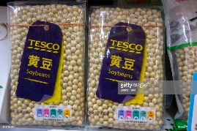



Modeling Approach
A.
B.
PRODUCTION
Plantation
Plantation
Productivity
Crop Price
Interest Rate
Real vs USD

Slide 6

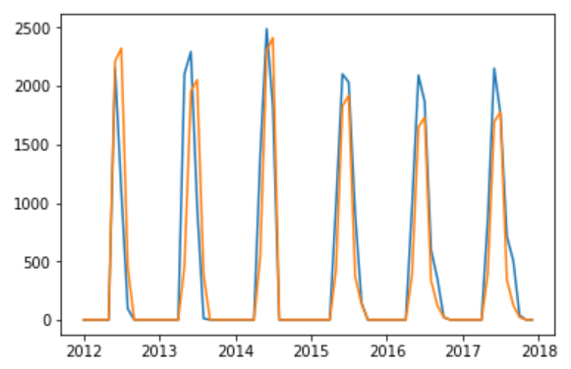
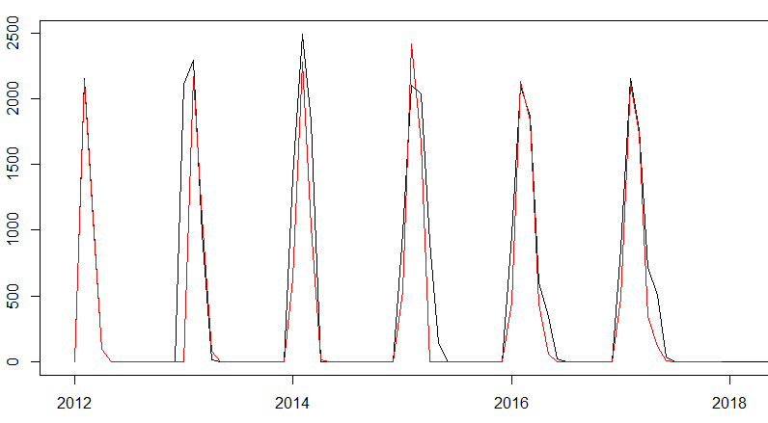
Models Tested for Production
1) Linear Regression
2) ARIMA (with Seasonality and External Variables)
1 Model for each crop = 3 Models Total
1 Model for each zone and crop = 25 Models Total
Production
Plantation
Year
Production
Plantation
Seasonal Differencing x 1
Month
FEATURES
Lag 1
Lag 2
Lag 3
Lag 4
Lag 12
Error Lag 12
Lag 3
Lag 11
Lag 12
Lag 13
Lag 5
State
Lag 4
Actual
Actual
Predicted
Predicted

Slide 7
Links for Data Sources
Yearly Production – Agroconsult
%Harvest and %Plantada – Agroconsult
Exchange Rate - https://fred.stlouisfed.org/series/DEXBZUS
Interest Rate - https://fred.stlouisfed.org/series/DEXBZUS
Milho Price - https://www.indexmundi.com/commodities/?commodity=corn
Soya Price - https://www.indexmundi.com/commodities/?commodity=soybeans

Slide 8
Model Fit Comparison
Real v/s Calculada

Slide 9
Soya Production
Comparison of Actual Data with Fitted Data

Slide 10
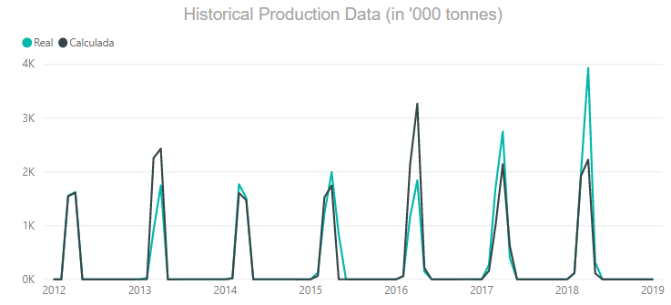
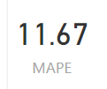
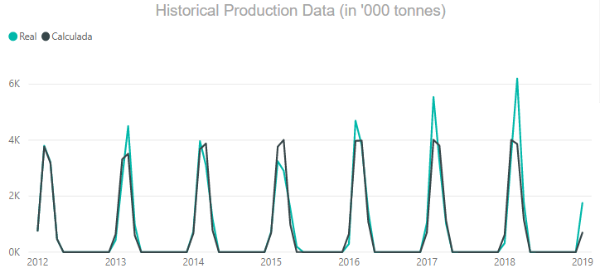

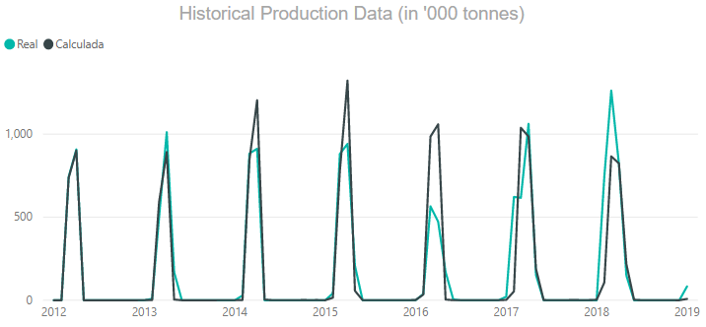

Bahia (BA)
Goias (GO)
Maranhao (MA)

Slide 11
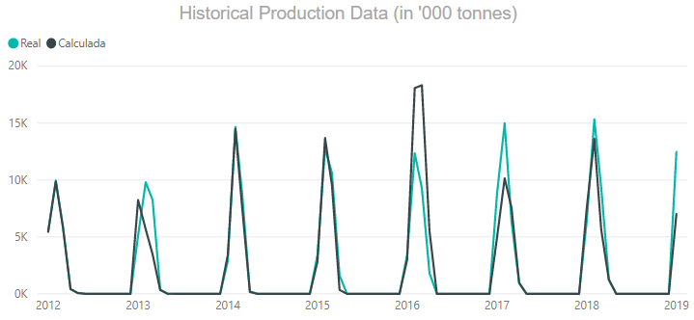

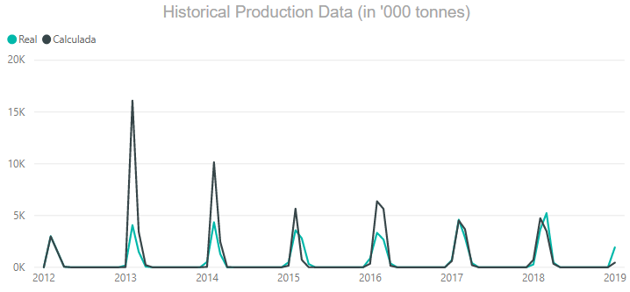

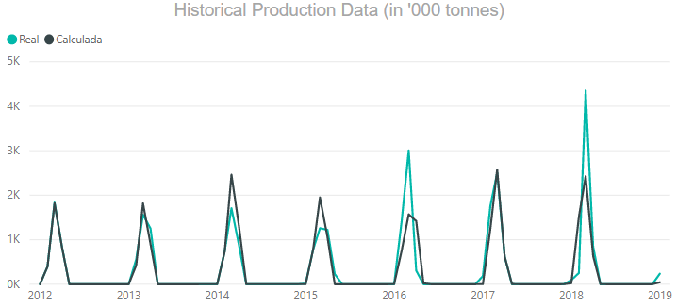

Matogrosso (MT)
Matogrosso Do Sul (MS)
Minas Gerais (MG)

Slide 12
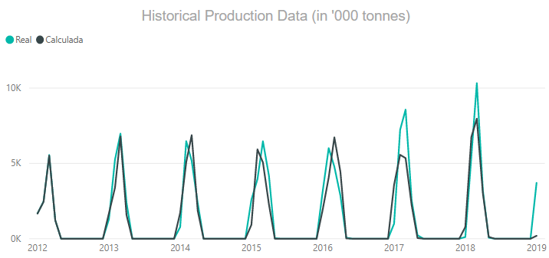

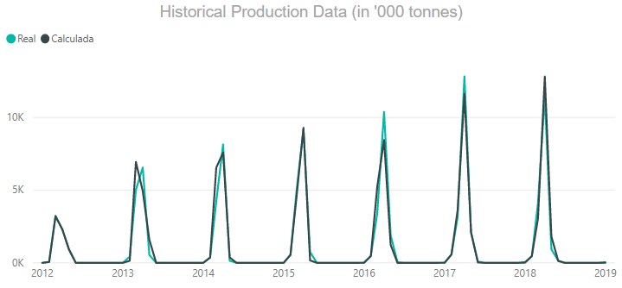

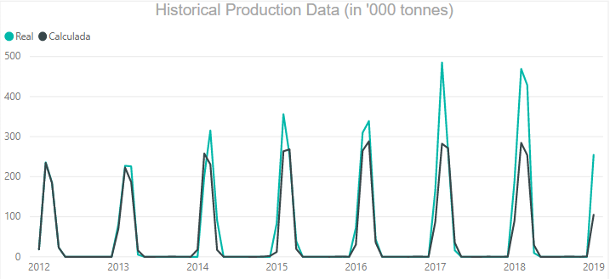

Parana (PR)
Rio Grande Do Sul (RS)
Rondonia (RO)

Slide 13
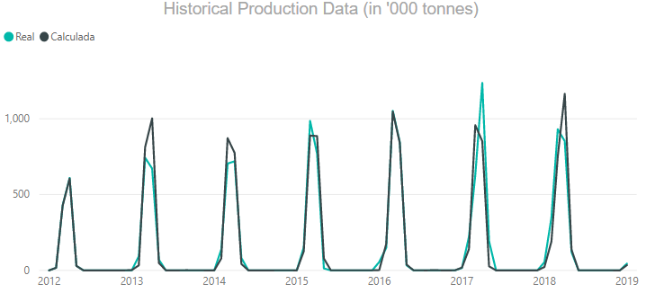

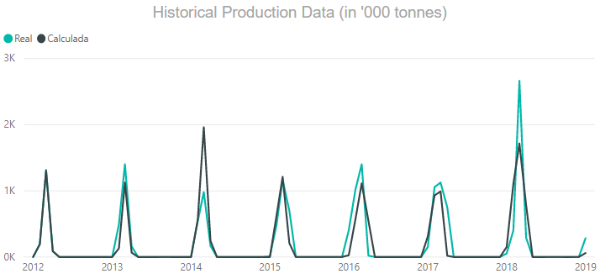

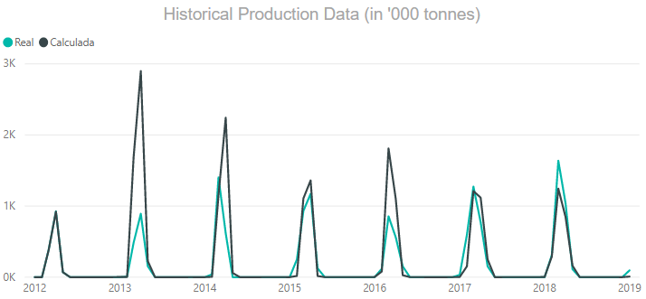

Santa Catarina (SC)
Sao Paulo (SP)
Tocantins (TO)

Slide 14
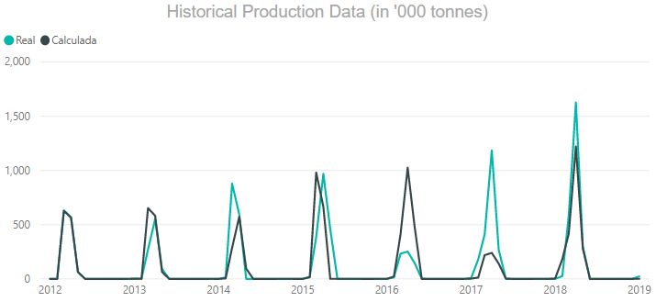

Piaui (PI)

Slide 15
Milho 1 Production
Comparison of Actual Data with Fitted Data

Slide 16
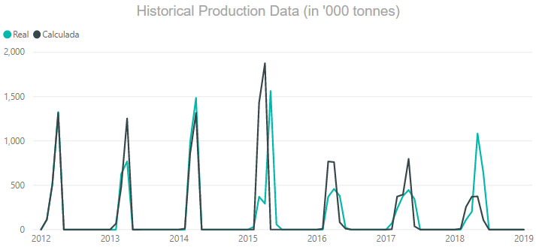

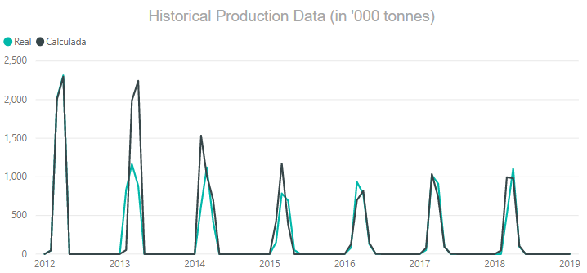

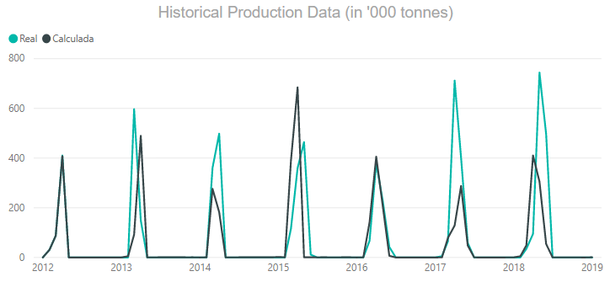
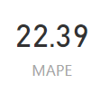
Bahia (BA)
Goias (GO)
Maranhao (MA)

Slide 17
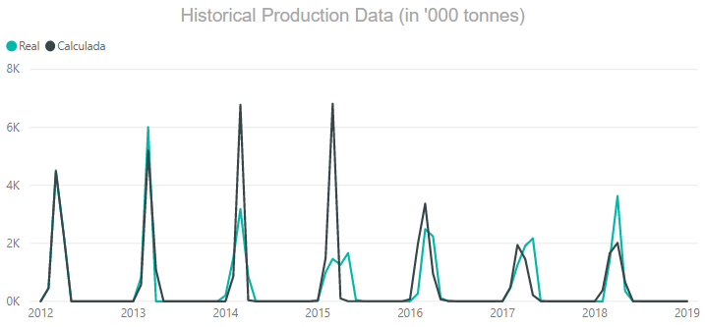

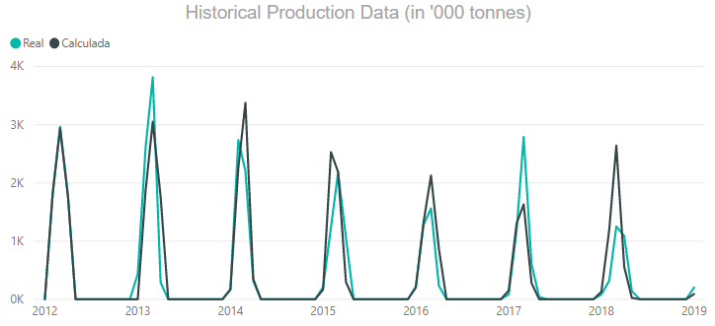

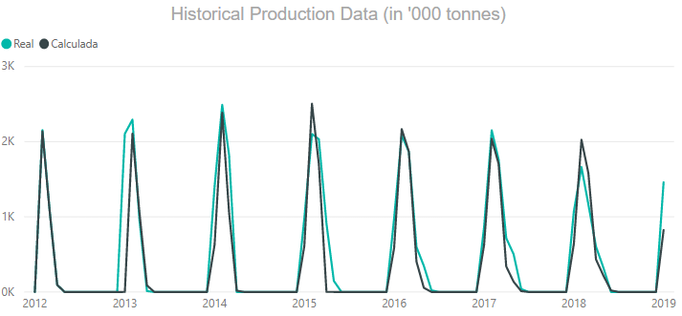

Minas Gerias (MG)
Parana (PR)
Rio Grande Do Sul (RS)

Slide 18
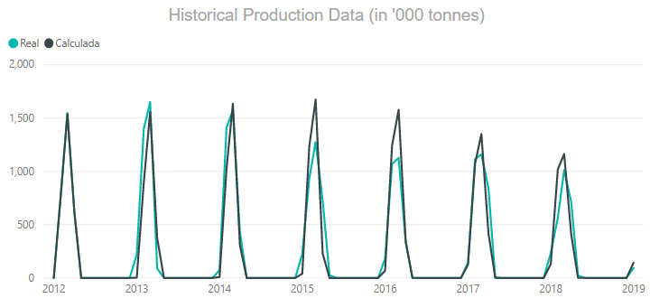

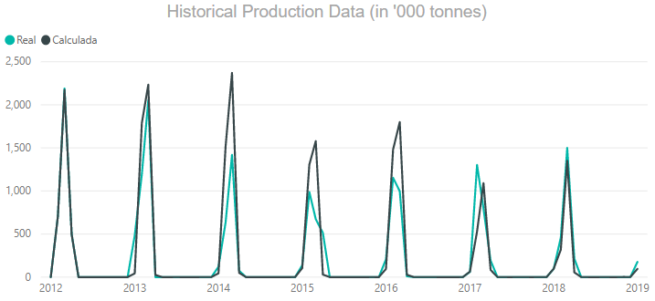

Santa Catarina (SC)
Sao Paulo (SP)

Slide 19
Milho 2 Production
Comparison of Actual Data with Fitted Data

Slide 20
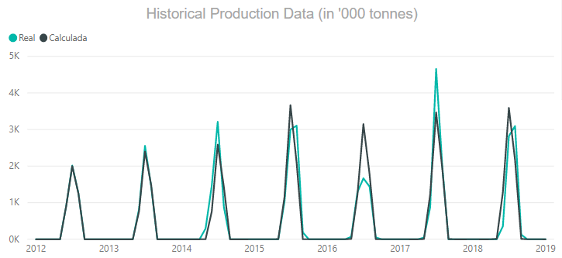

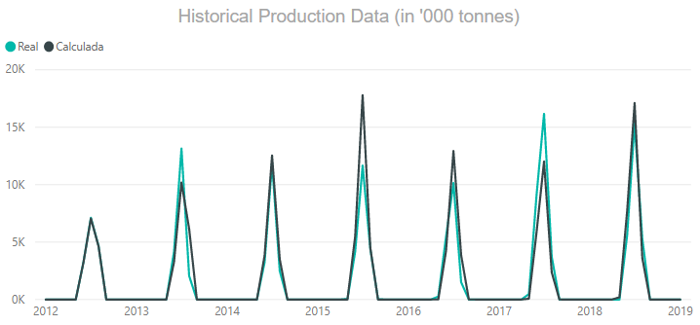

Goias (GO)
Mato Grosso (MT)

Slide 21
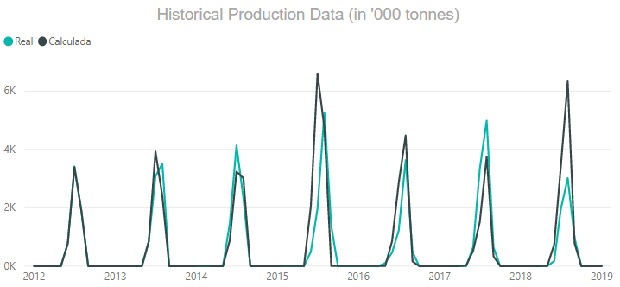

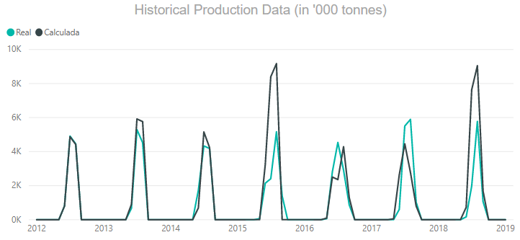

Matogrosso Do Sul (MS)
Parana (PR)

Slide 22
Thank You
DXC Technology

